Slide 1

Acropolis institute of technologyand research
Indore Bypass Road,Manglia Square Indore (M.P)

Slide 2

MINOR PROJECT ON “used BOOKs”
2018-19
Project Guide
Prof. Anita Mahajan

Slide 3
GROUP MEMBERS
Monisha Kanoje(0827IT151065)
Prachi Jain(0827IT151079)
Prachi Rathore(0827IT151080)
Shruti Shrivastava(0827IT151109)

Slide 4
Project Presentation Outline
◻Abstract
◻Introduction
◻Problem Statement
◻Survey of Existing Systems
◻Project Objectives
◻Solution Proposed
◻Models and Diagrams
◻The implementation
◻The Outcome discussion
◻Conclusions and Limitations

Slide 5
Abstract
The proposed system will offer a web based interface for students to conveniently find buyers for their used books. Students will be able to offer their used books for sell at their own prices but less than the original price. Students wishing to buy will be able to search the listing for the desired book and order it from any seller that is offering the book. The system will not deal with monitory transaction directly. The seller and buyer will agree on the payment and book delivery method. We will just give them a platform to meet their requirements.

Slide 6
Introduction
Every year millions of students spend thousands of rupees to buy their text books, knowing fully well all these books will be of no relevance after the semester. Some books get donated to libraries or other schools, some are resold to new students, and some go to charity and a bulk of it find their way either with the paanwala, or the peanut seller on roads. This was the same routine that we all had followed as a student until now .So we from this engineering days, proposed the online used textbook in our website. The portal allows all the graduating and under graduating students to buy and sell , old used textbooks . The seller and the buyer will look how they have to pay and deliever.

Slide 7
PROBLEM STATEMENT
After the completion of required course, students have many books regarding their course which is not in use, and also the new books are much expensive to buy first hand as compared to second hand for students.

Slide 8
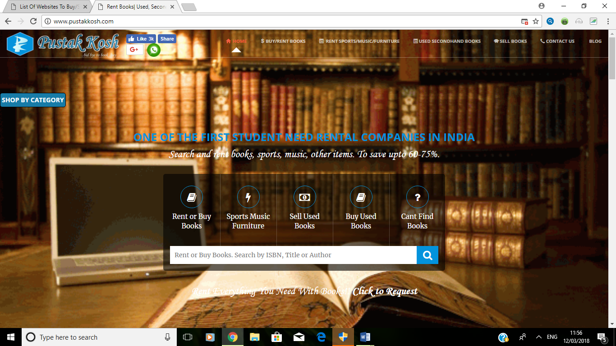
Survey of Existing System
Pustakkosh :-

Slide 9
Advantage
When students rent books from Pustakkosh, they pay a security deposit along with the rent. The deposit is returned as soon as the book is returned.
For students who do need books for ownership, the company provides an option of buying pre-rented books, marked for sale, which again brings down the cost. This option is available to students across India.
Students can sell their books to Pustakkosh too.

Slide 10
Disadvantage
The business is dependent on logistics boys to deliver and pick up books. Initially, logistics posed a big bottleneck because courier companies would not serve a startup company. Based on customer analytics they came up with innovations, like fulfilment centres, closer to colleges, which helped them overcome the challenge of working with courier companies.
Digital content: The company needs to move beyond physical books.

Slide 11
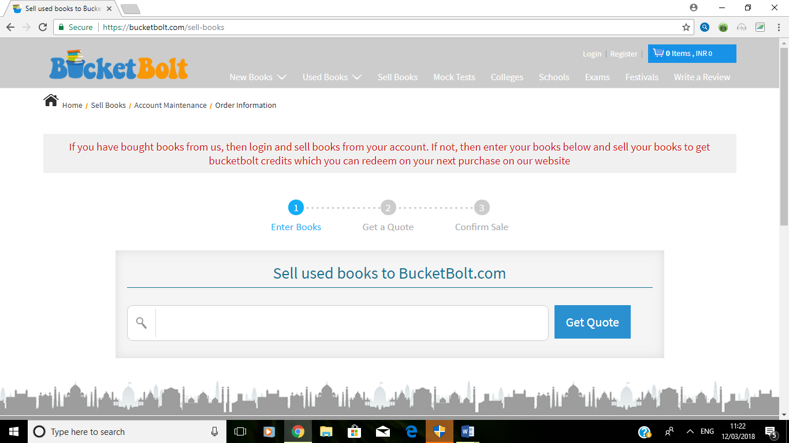
Bucketbolt

Slide 12
Advantage
Increased web traffic and improved Google page ranking.
Contemporary design easily connect with target customers - the students.
Increased in sales and revenue.
New fresh look with user-friendly interface and easy navigation makes it popular with customers.
Better use of technology makes it robust, secure and scalable.

Slide 13
Disadvantage
You can only sell books after one year of purchase from this site only.
Whenever you sell the books on bucketbolt you can only get the bucketbolt credits not the money.

Slide 14
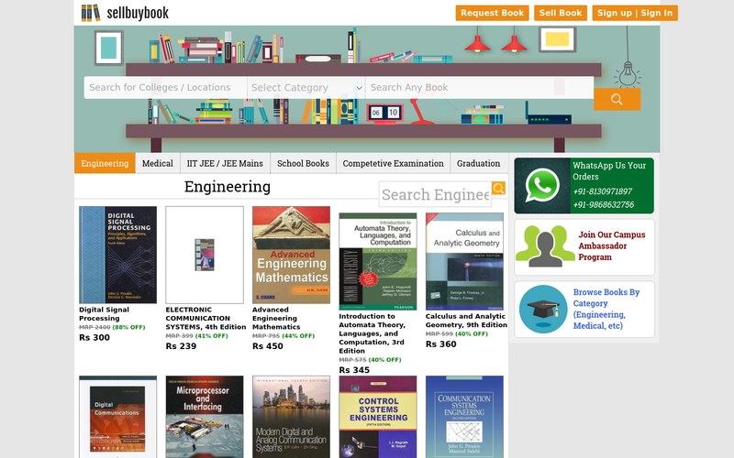
Sellbuybook

Slide 15
Advantages
It provide home delivery of books at Minimum price possible.
All books we provide are in good condition and at cheapest rate in the Market.
This site enable us to give Cash on Delivery facility, only make Payment if you like the Book.
Disadvantages
Books are a necessity of Today’s India, almost every person need books. All section of society, all age-groups need and loves Books. So we can expand to whole India touching lives of every citizen.
But this site focus will be on College Students, Novel readers and book lovers, Students preparing for IIT-JEE, AIIMS, Medical, Engineering, GATE and other Competitive Exams.
We also plan to introduce Books of all Category in next few Months but has not proposed till yet.

Slide 16
Objective
Develop an efficient book selling / buying system for second hand books.
Unlike normal system no additional convince charges added.
To make system secure and user friendly.

Slide 17
SOLUTION PROPOSED
This website is developed to make it easy for the people to buy and sell any used book at anywhere without giving much time and also without much selection. The web portal can be opened on any platform.

Slide 18
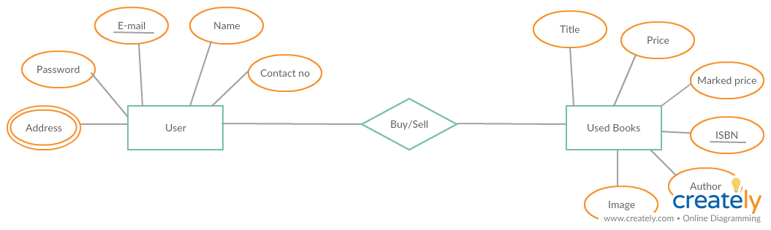
Models/Diagrams ER Diagram

Slide 19
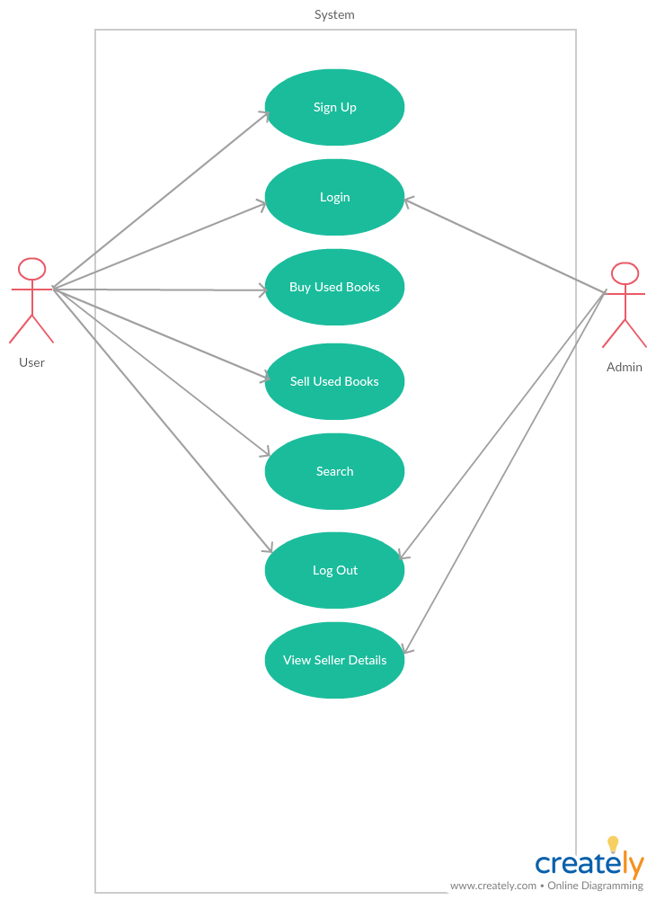
Use Case

Slide 20
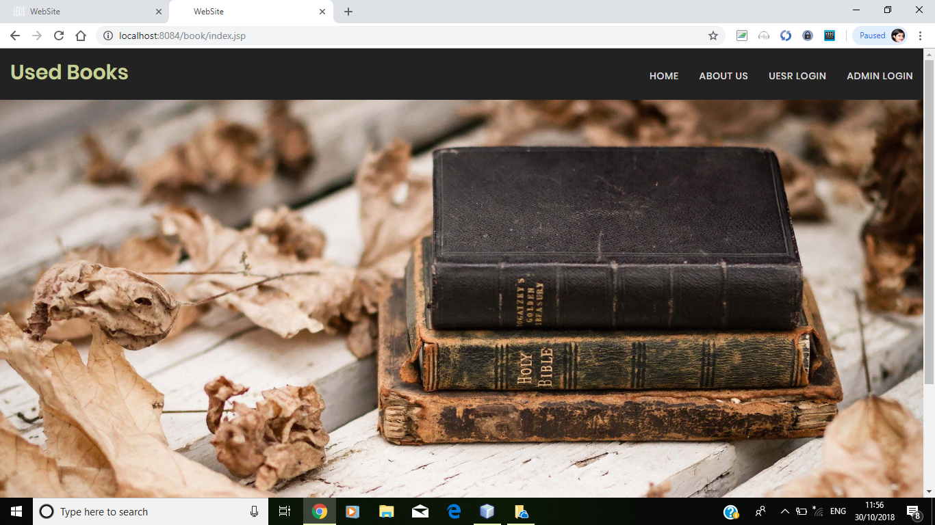
Implementation Home Page

Slide 21
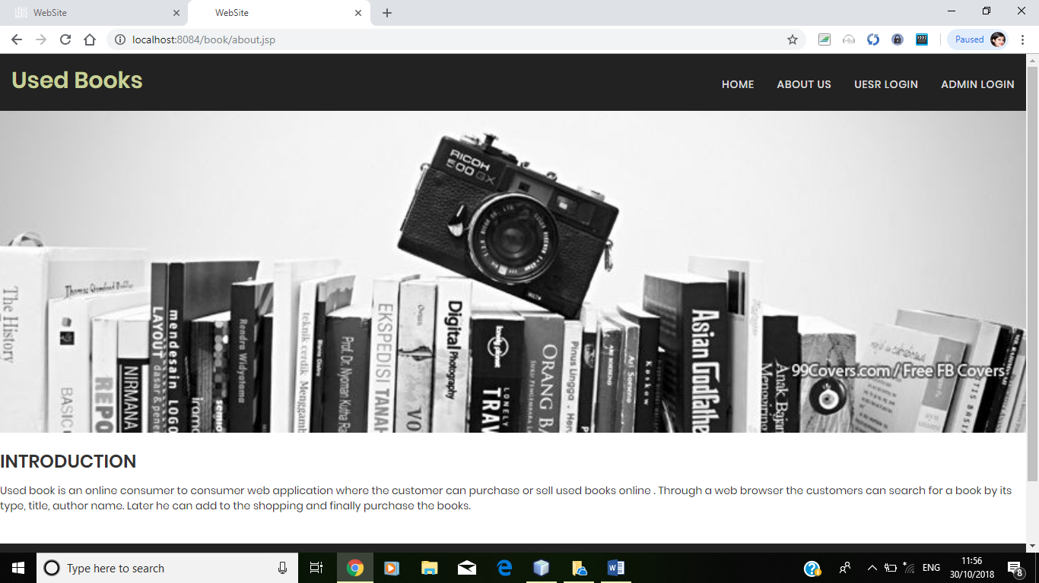
About us

Slide 22
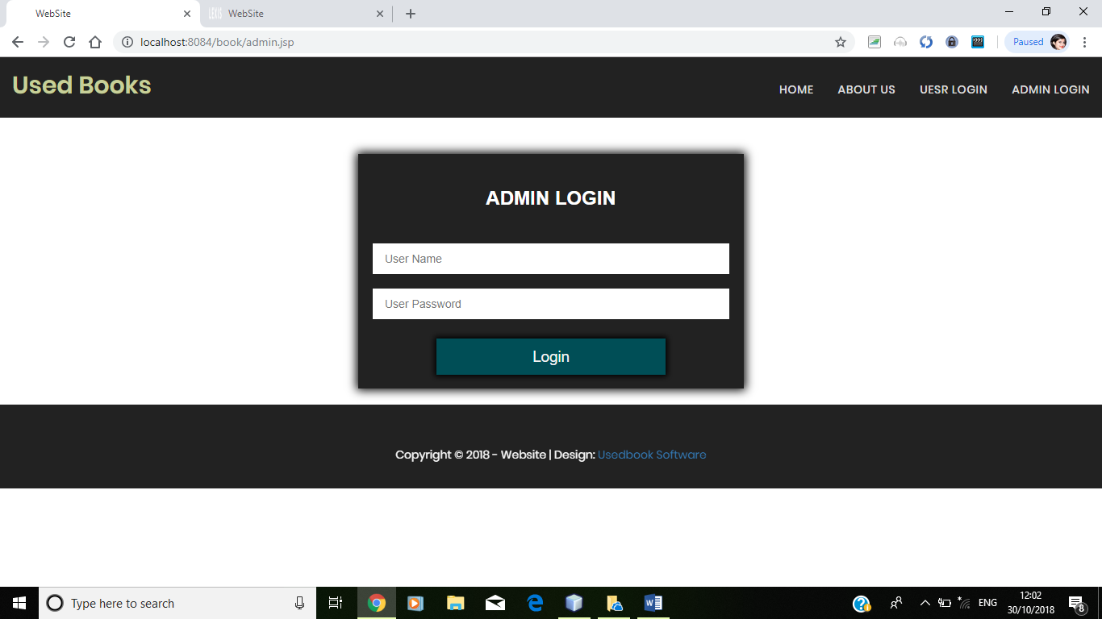
Admin Login

Slide 23
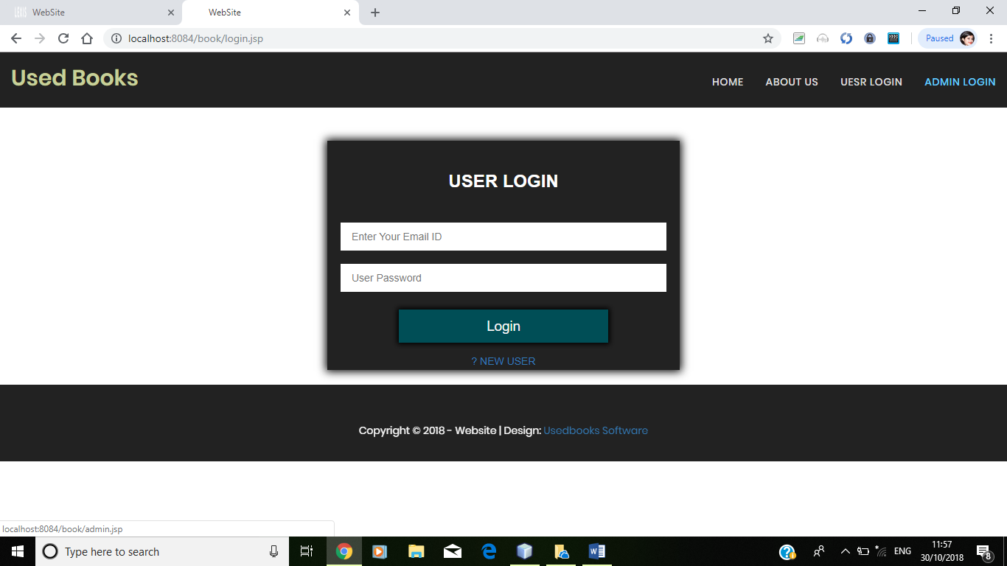
User Login

Slide 24
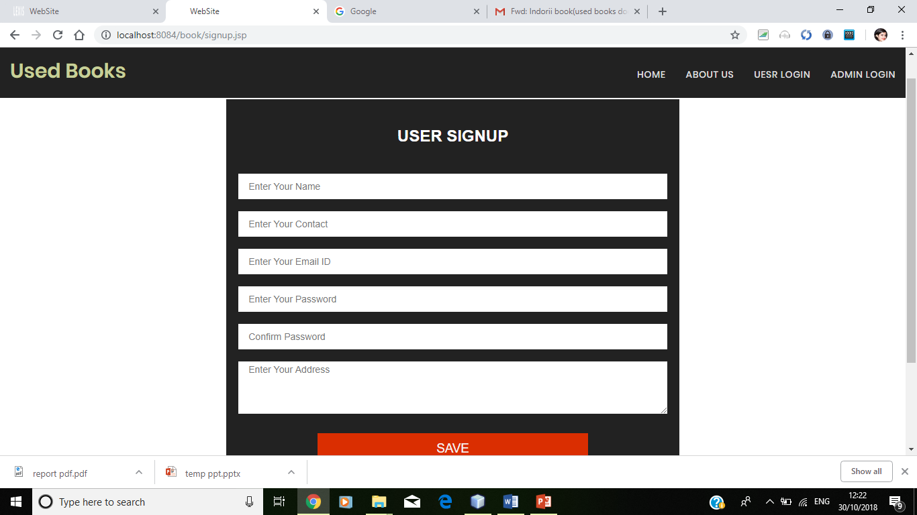
User Sign UP

Slide 25
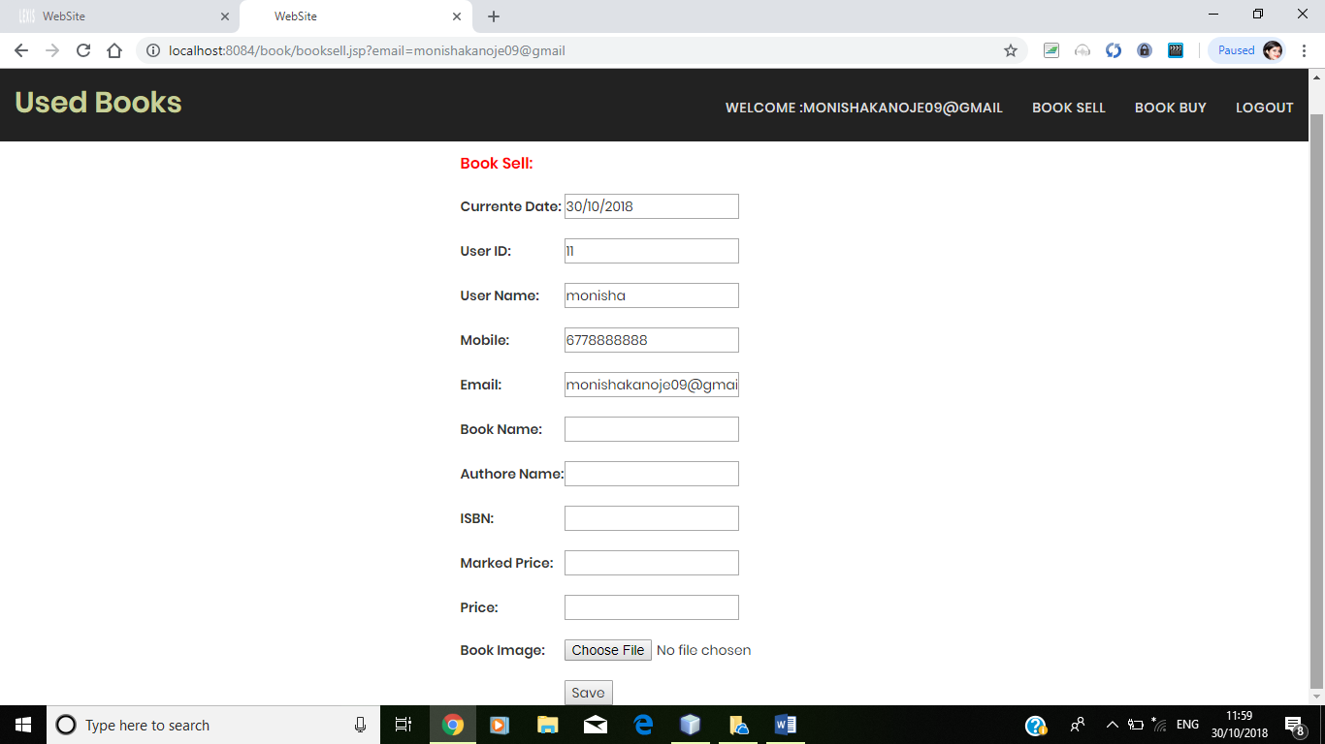
Book sell

Slide 26
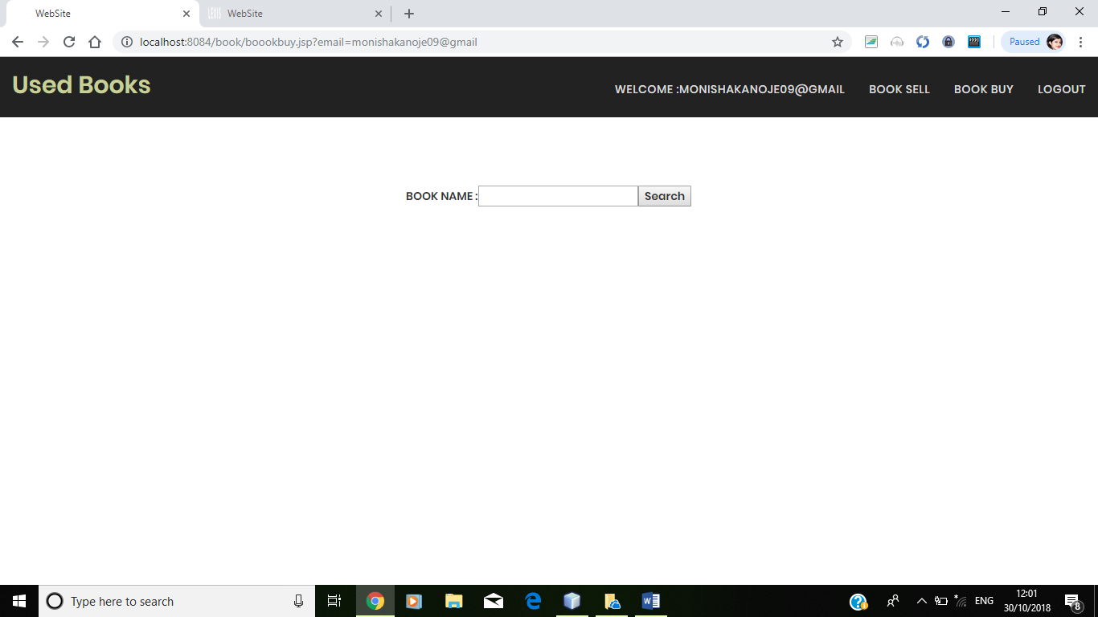
Search

Slide 27
The Outcome discussion
Cost Saving
Time Saving
Fast purchasing
Educational/course books
Offering a platform to buy and sell online books(used books).

Slide 28
Conclusion
It is design to make it easier to buy and sell used books. This is very useful for any student who has completed his/her required course. Its users ease to buy and sell their books for just few clicks and with the efficient price, no additional convince charge is added to the book price. This system is secure and user friendly.
User is provided with many options like search, upload etc.
The main feature of this system is that it is platform independent. Hence, user can access from any corner of the world using any device.

Slide 29
Limitation
The limitation of Used Books
You can purchase the books but you cannot read the books online free of cost.
The project does not store transaction. So the buyer will not able to make any references to past transactions.
Do not have payment gateway.

Slide 30
Thank-you

